Slide 1
COMSATS UNIVERSITY / ECO346 / FALL 2026
FA24-BED-028 · 01 / 04
EDUCATION, SEEN THROUGH DATA
The same region.
Very different literacy outcomes.
46.6
percentage-point
literacy gap
Among people aged 45–49
How can data visualization reveal inequality in rural Khyber Pakhtunkhwa?
Men 57.0% · Women 10.5%
An analysis of education spending and literacy using PSLM 2019–20, weighted survey data, and reproducible code.
The graph makes this contrast visible. It does not, on its own, tell us why it exists.
LOCATION
METHOD
OUTPUT
PRESENTER
Rural KP
Survey-weighted
3 R figures + 1 Python
Fatima Shahid
Notes:
0:00–1:05 | Start with a question rather than the assignment title. ‘If two adults belong to the same age group and live in rural KP, does literacy look equal for women and men?’ Pause. ‘Among 45–49 year-olds in this sample, 57.0% of men and 10.5% of women are literate—a difference of approximately 46.6 percentage points when calculated before rounding.’ Explain the project covers both education spending and literacy. This is a descriptive finding, not a causal explanation. Transition: ‘Let me show you why the way I plotted the data mattered.’

Slide 2
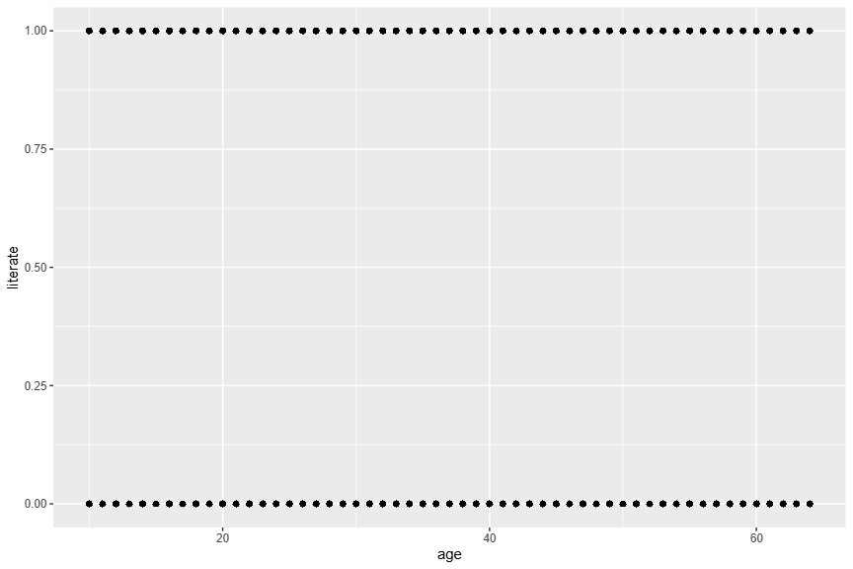
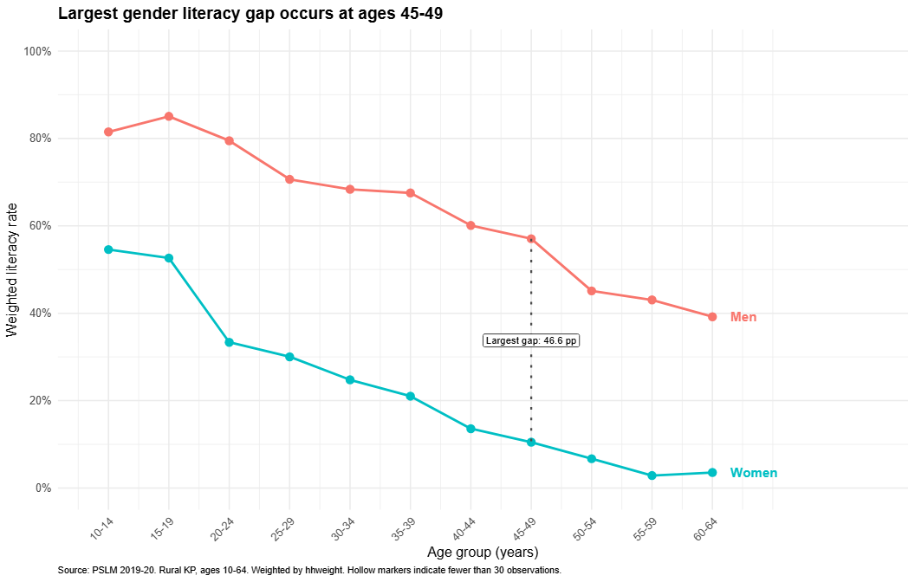
ECO346 / DATA VISUALIZATION TECHNIQUES FOR ECONOMISTS
DESIGN · 2 / 04
One dataset. Two very different views.
A makeover that replaces overplotting with survey-weighted, age-specific comparisons.
BEFORE / DEFAULT SCATTERPLOT
AFTER / WEIGHTED LITERACY BY AGE
01 Less overplotting
02 Easier comparisons
03 The finding stands out
Individual 0/1 dots → weighted
means in five-year age bands.
Two connected series on the
same percentage scale.
Direct labels and the largest
gender-gap annotation.
PSLM 2019–20 · Rural Khyber Pakhtunkhwa (Variant 4) · Fatima Shahid
2 / 04
Notes:
1:05–2:20 | First, point to the left: ‘This is the default R graph: one dot per respondent, literacy recorded as zero or one.’ Ask the professor to notice how the points overlap and obscure any gradient. Then point to the right: ‘I redesigned the chart by calculating survey-weighted literacy rates in eleven five-year age bands and separating men and women.’ Identify three principles: remove overplotting with conditional means; compare positions on a common axis; annotate the largest gap and label series directly rather than sending viewers to a legend. Mention a trade-off: the redesigned graph hides individual-level observations and within-band variation.

Slide 3
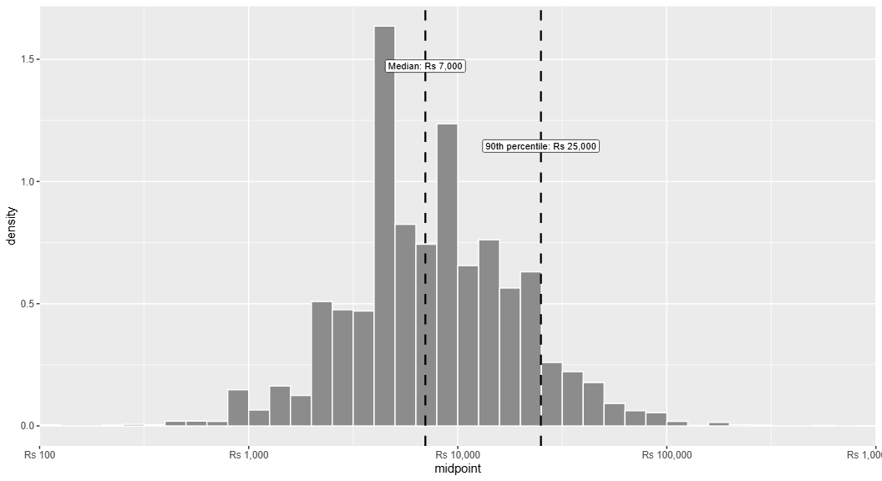
ECO346 / DATA VISUALIZATION TECHNIQUES FOR ECONOMISTS
SPENDING · 3 / 04
Education spending is unevenly distributed.
Annual spending among students in rural KP; the axis uses a logarithmic scale.
WEIGHTED DISTRIBUTION
Rs 7,000
Weighted median
Rs 25,000
90th percentile
4,912 students
3 outside the plotted range of Rs 100–1,000,000.
READING THE GRAPH | The distribution spans a wide range. Weighted statistics describe the pattern; they do not explain its causes.
PSLM 2019–20 · Rural Khyber Pakhtunkhwa (Variant 4) · Fatima Shahid
3 / 04
Notes:
2:20–3:30 | ‘The second research question is how much households spend on each student’s education.’ The graph uses a log10 x-axis because spending spans from hundreds to large values. The sample contains 4,912 students, with three values outside the plotting range. ‘The weighted median is Rs 7,000 per year, while the weighted 90th percentile is Rs 25,000. This means the upper part of the distribution has substantially higher spending than a typical student.’ Explain that survey weights adjust each respondent’s contribution to population representation and density is shown per log10 unit, not raw counts. Avoid claiming the histogram identifies the cause of unequal spending.

Slide 4
ECO346 / DATA VISUALIZATION TECHNIQUES FOR ECONOMISTS
CONCLUSION · 4 / 04
The pattern is clear. The explanation needs care.
The literacy gender gap persists across the age bands—and the R results reproduce in Python.
LITERACY RATES · RURAL KP
CHECKED IN TWO LANGUAGES
Ages 15–19
22 / 22
Men
85.1%
Age–sex literacy cells matched between R and Python to one decimal place.
Women
52.6%
Ages 45–49
IMPORTANT LIMITATION
Men
57.0%
These are cross-sectional associations. The graphs do not establish why the literacy gap exists, or how an individual’s literacy changes over time.
Women
10.5%
Largest gap: 46.6 percentage points at ages 45–49
Better graphs make inequality easier to see; careful interpretation keeps us from overstating the evidence.
PSLM 2019–20 · Rural Khyber Pakhtunkhwa (Variant 4) · Fatima Shahid
4 / 04
Notes:
3:30–5:00 | ‘The final finding is consistent across cohorts: male literacy is higher in every five-year age band in the study.’ At ages 15–19, 85.1% of men versus 52.6% of women are literate. At ages 45–49, the difference is especially large: 57.0% versus 10.5%, approximately 46.6 percentage points using the unrounded rates. ‘To check the calculations, I reproduced the weighted band table in Python. All 22 age-by-sex rates matched R to one decimal place.’ End with a cautious economic interpretation: the figures describe inequalities across age groups, but the cross-sectional data cannot tell us the causes, nor can they be treated as within-person changes over time. Close: ‘Better graphs make inequality easier to see; careful interpretation tells us what we can—and cannot—conclude.’

